Slide 1
Meeting Water Planning Goals with New Data on Urban Conservation Programs
Katie Anderson, CEO

Slide 2
WORLD TOILET DAY
November 19, 2015

Slide 4
Project Overview
Low-hanging fruit: conservation without behavior change or capital-intensive infrastructure
Targeting high-density real estate
100 unit apartment complex is the same as 100 single-family homes but with just one driveway
Projecting savings with data
Comprehensive audit of historical water consumption
Monitor occupancy and tenant density

Slide 5
Project Overview
Baseline program: showerheads, aerators, manifolds, drips/leaks, rebuild toilets
Benchmarked to 55 gpcd
Crew member can complete 7 units per day
Baseline program plus toilet replacement: everything in baseline plus replace current toilets
Benchmarked to 40 gpcd
Crew member can complete 2 units per day

Slide 6
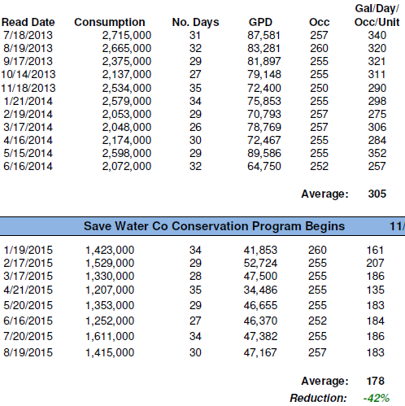
Case Study: Baseline
260 units/10 days
Water Savings
984,000 gallons/
3.02 acre-feet per month
11,808,000 gallons/
36.24 acre-feet per year

Slide 7
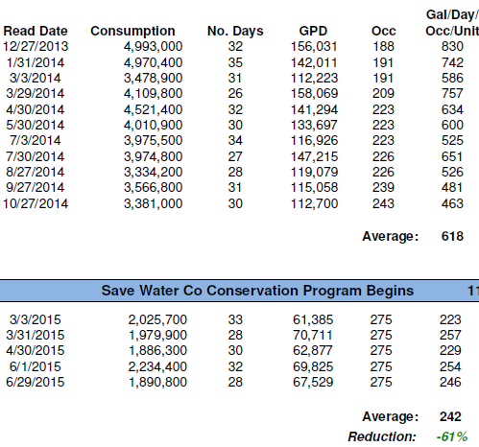
Case Study: Baseline
348 units/15 days
Water Savings
3,128,300 gallons
9.60 acre-feet per month
37,539,600 gallons
115.21 acre-feet per year

Slide 8
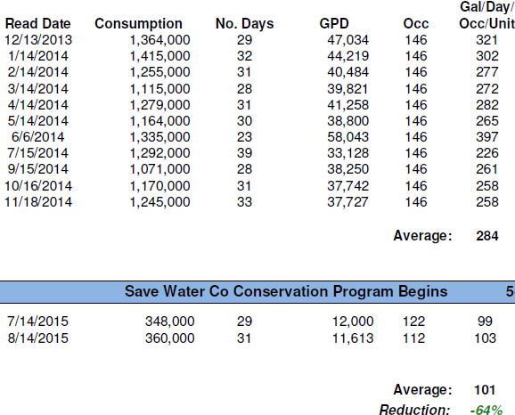
Case Study: Baseline plus Toilets
154 units/7 days
Water Savings
641,000 gallons/
1.97 acre-feet per month
7,690,000 gallons/
23.60 acre-feet per year

Slide 9
Project Impact

Slide 10
Just One Leak

Slide 11
Toilet Truth
Region L 2015 IPP Assumptions:
Toilet retrofit 25 yr lifespan, showerhead/aerator 15 yrs
Out of 6400 units

Slide 12
Toilet Truth
(up to 4.84)
(up to 4.08)
(up to 2.22)
(up to 2.34)
Lower labeled use does not necessarily guarantee consistency or durability

Slide 13
Regional Impact
Potential new water with full implementation of such conservation programs:
Region C: 81,000 acre-feet
Region H: 75,000 acre-feet
Region K: 21,000 acre-feet
Region L: 23,000 acre-feet

Slide 14
Project Cost
$1,100 per acre-foot Save Water Co baseline program
1 acre-foot per approx. 9.5 units
Approx. $120 per unit
$2,607 per acre-foot baseline plus toilet replacement
1 acre-foot per approx. 6.6 units
Approx. $395 per unit
$250 per acre-foot after initial implementation

Slide 15
Cost Comparison
2012 SWP: $6,000 per acre-foot for all new sources ($53 Billion total)

Slide 16
Project Benefits
Real-world monitoring and data
Does not depend on behavior change
Eases urban – rural competition
Enlists “unengaged middle”

Slide 17
Contact Info
Katie Anderson
kanderson@savewaterco.com
@SaveWaterCo

