Slide 2
Agenda
About RAP
K-12 Education Program
Program Advantage
Results

Slide 3
About RAP

Slide 4
About RAP
Founded in 1993
K-12 Education, Direct-to-Customer & Small/Medium Business Programs
Over 4,000 Programs Implemented
Program Size Runs From 9 to 80,000 Participants
300+ Programs & 550,000+ Households Served Annually
80,000 Sq Ft Nevada Program Center

Slide 5
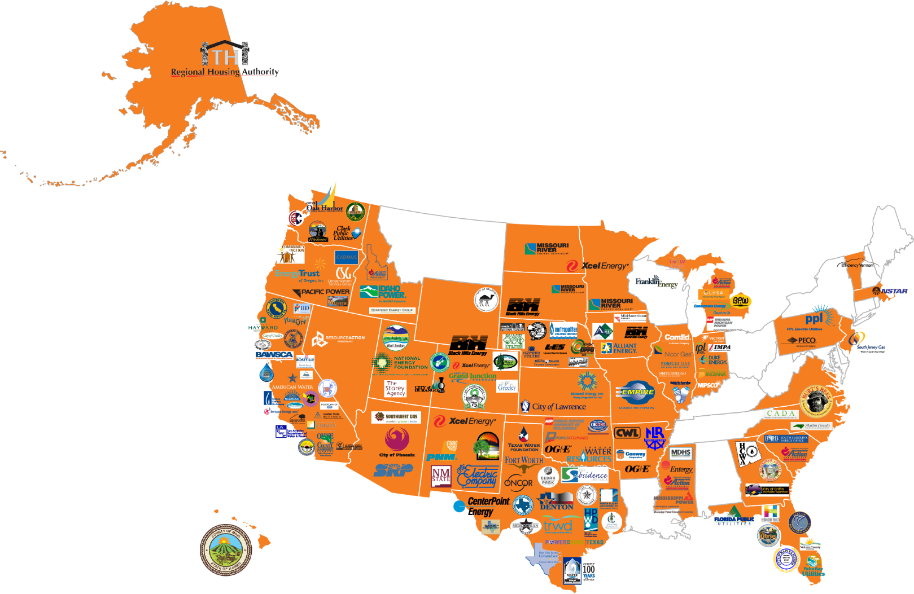
National Footprint
35 U.S. States & Parts of Canada

Slide 6
Measure-Based
Education®
Measure-Based Education® (MBE) is a combination of cost-effective measures blended with interactive, efficiency education. MBE achieves resource savings, customer engagement, and behavioral change.

Slide 7
K-12 Education Program
Program Methodology
Interactive Educational Materials
Take-Home Kits
Designed to Produce Verified Water and Energy Savings
Education Combined with Measures Results in Behavior Change

Slide 8
Curriculum Development
Utilizes Differentiated Instruction
Includes Regional & Relevant Content
Meets State (TEK)
Reinforces Measure Installation

Slide 9
Differentiated Instruction
Visual, Auditory & Kinesthetic Learning
Reduces Barriers to Learning
Offers Multiple Options to Demonstrate Knowledge
Reaches More Students
Encourages Parent Participation

Slide 10
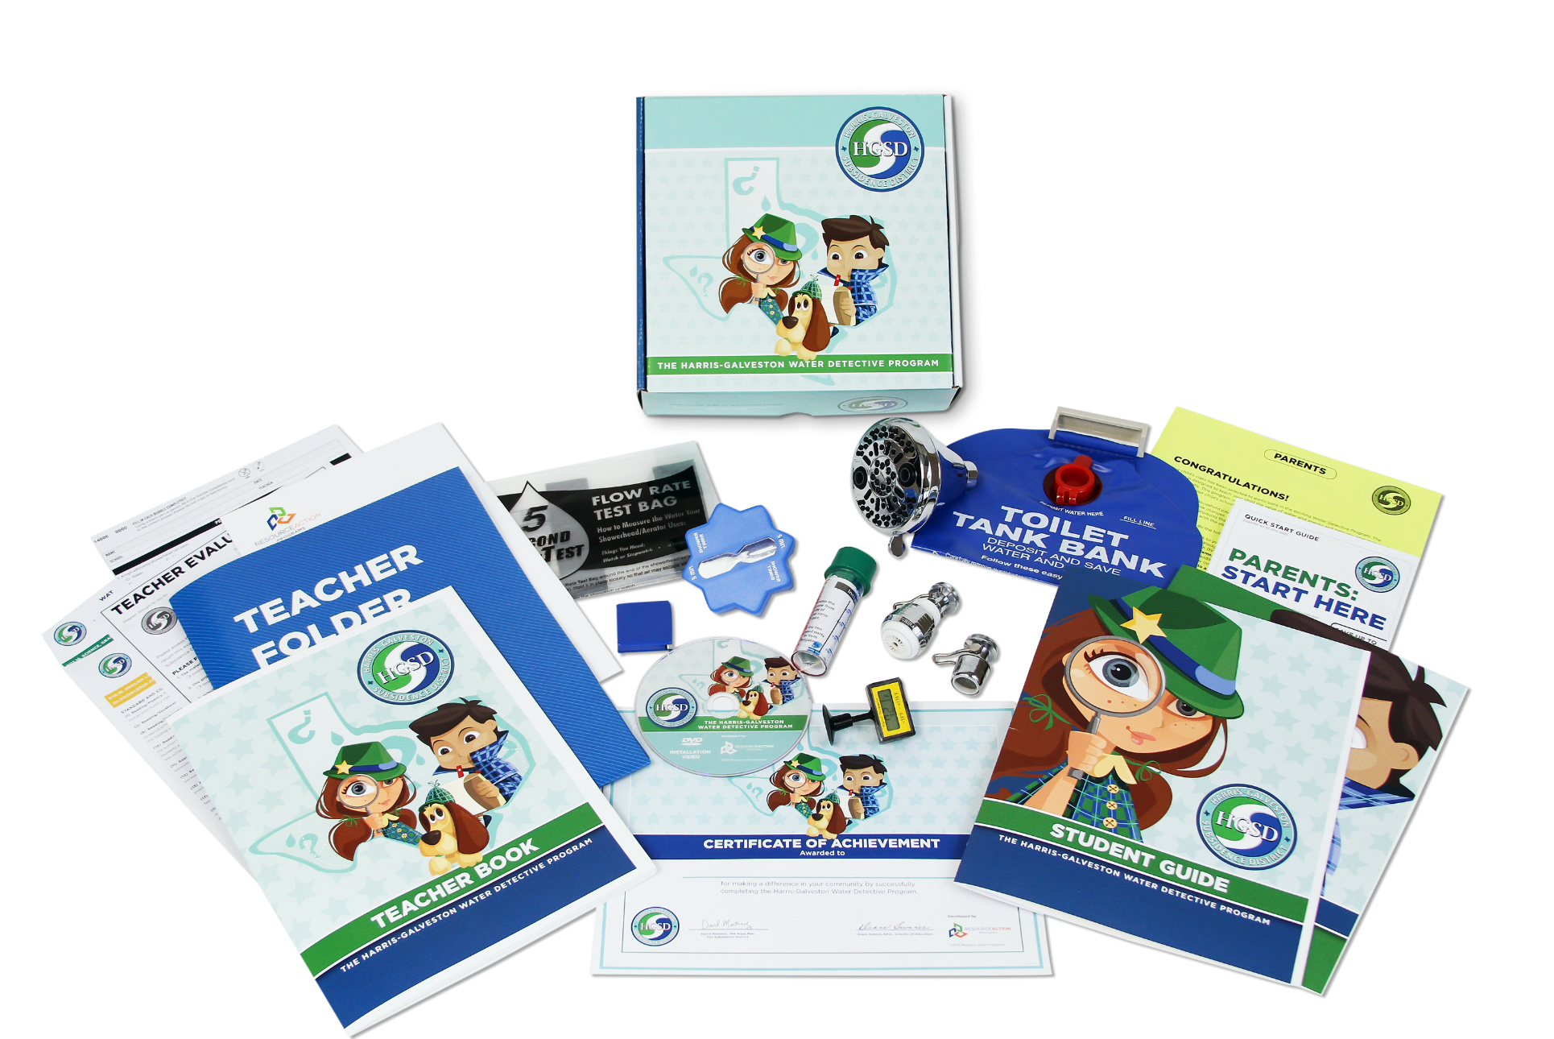
Materials Customization

Slide 11
Program Advantage

Slide 12
All-Inclusive
Program Delivery
Curriculum Development
Customized Materials
Data Tracking & Reporting
Energy Efficiency Measures
Graphic & Web Design
Kit Assembly
Marketing Communications
Printing
Program Management
Shipping
1:1 Teacher Contact
Warehousing

Slide 13
Program Management
PMP® Certified Project Managers
Additional MBAs & CEM® Certified Employees
Concept-to-Completion
Utilizing a Cross-Functional Team of Industry Professionals
Notes:
Brand-Aligned Kit Box & Print Materials
Custom Die-Cut Kit Insert
Created for Utility-Specific Needs
Custom Illustration & Design

Slide 14
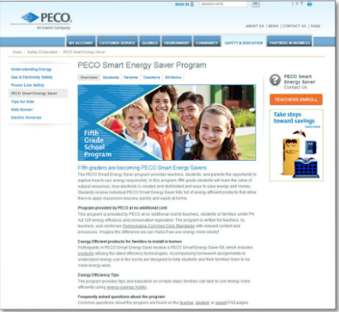
Marketing &
Communications
Fully Brand-Aligned Customization
Utility-Specific Data & Cross-Promotion
Positive Brand Recognition Events
Notes:
Brand-Aligned Kit Box & Print Materials
Custom Die-Cut Kit Insert
Created for Utility-Specific Needs
Custom Illustration & Design

Slide 15
Graphic & Web Design
Four Full-Time Professionals
Decades of Experience
Cohesive Print & Web Materials
Notes:
Brand-Aligned Kit Box & Print Materials
Custom Die-Cut Kit Insert
Created for Utility-Specific Needs
Custom Illustration & Design

Slide 16
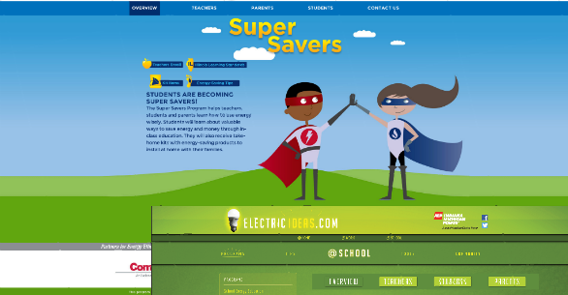
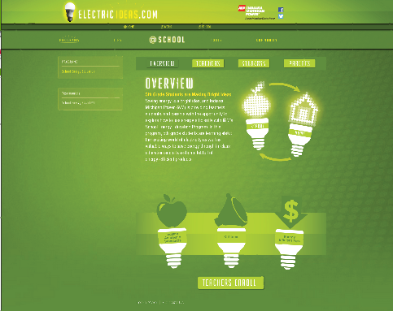
Full Service IT Department:
Custom Websites
iFrame
Utility Landing Page
Resources for Teachers, Students & Parents
Notes:
Brand-Aligned Kit Box & Print Materials
Custom Die-Cut Kit Insert
Created for Utility-Specific Needs
Custom Illustration & Design

Slide 17
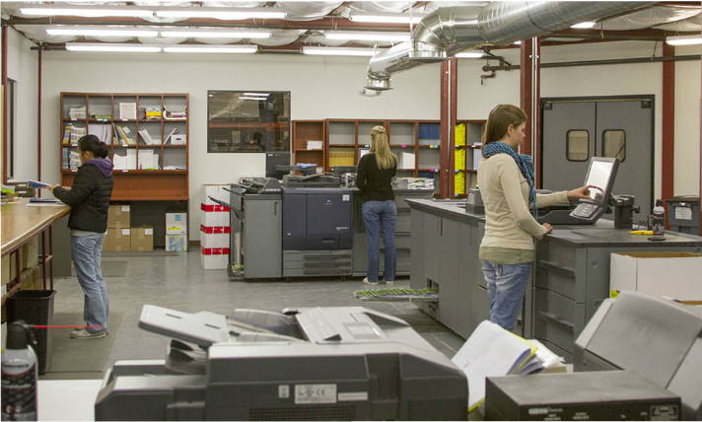
Full Service Print Shop
2 Production Konica Bizhub Pro 1250 B&W
125 Pages per Minute Each
Up to 3,000 Books per Day or Individually 1,500 per Day
1 Production Konica Bizhub Pro C1085 Color
Print Rate of Speed Does Not Change with Increase in Paper Weight or Size
Notes:
Brand-Aligned Kit Box & Print Materials
Custom Die-Cut Kit Insert
Created for Utility-Specific Needs
Custom Illustration & Design

Slide 18
Shipping & Receiving
All Materials Produced at RAP
Packaged Individually for Teachers
Delivered Directly into the Classroom
Subject to Ten-Step QA/QC Process

Slide 19
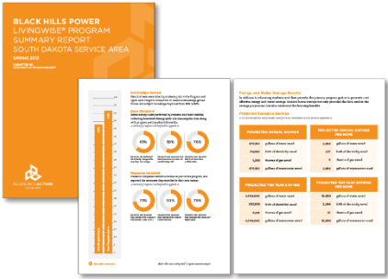
Data Collection & Reporting
Regular Reporting Intervals
Student Survey, Teacher & Parent Evaluations
Scan, Tabulate, Store Data & Prepare Reports
Furnish Annual Program Summary Report

Slide 20
Results

Slide 21
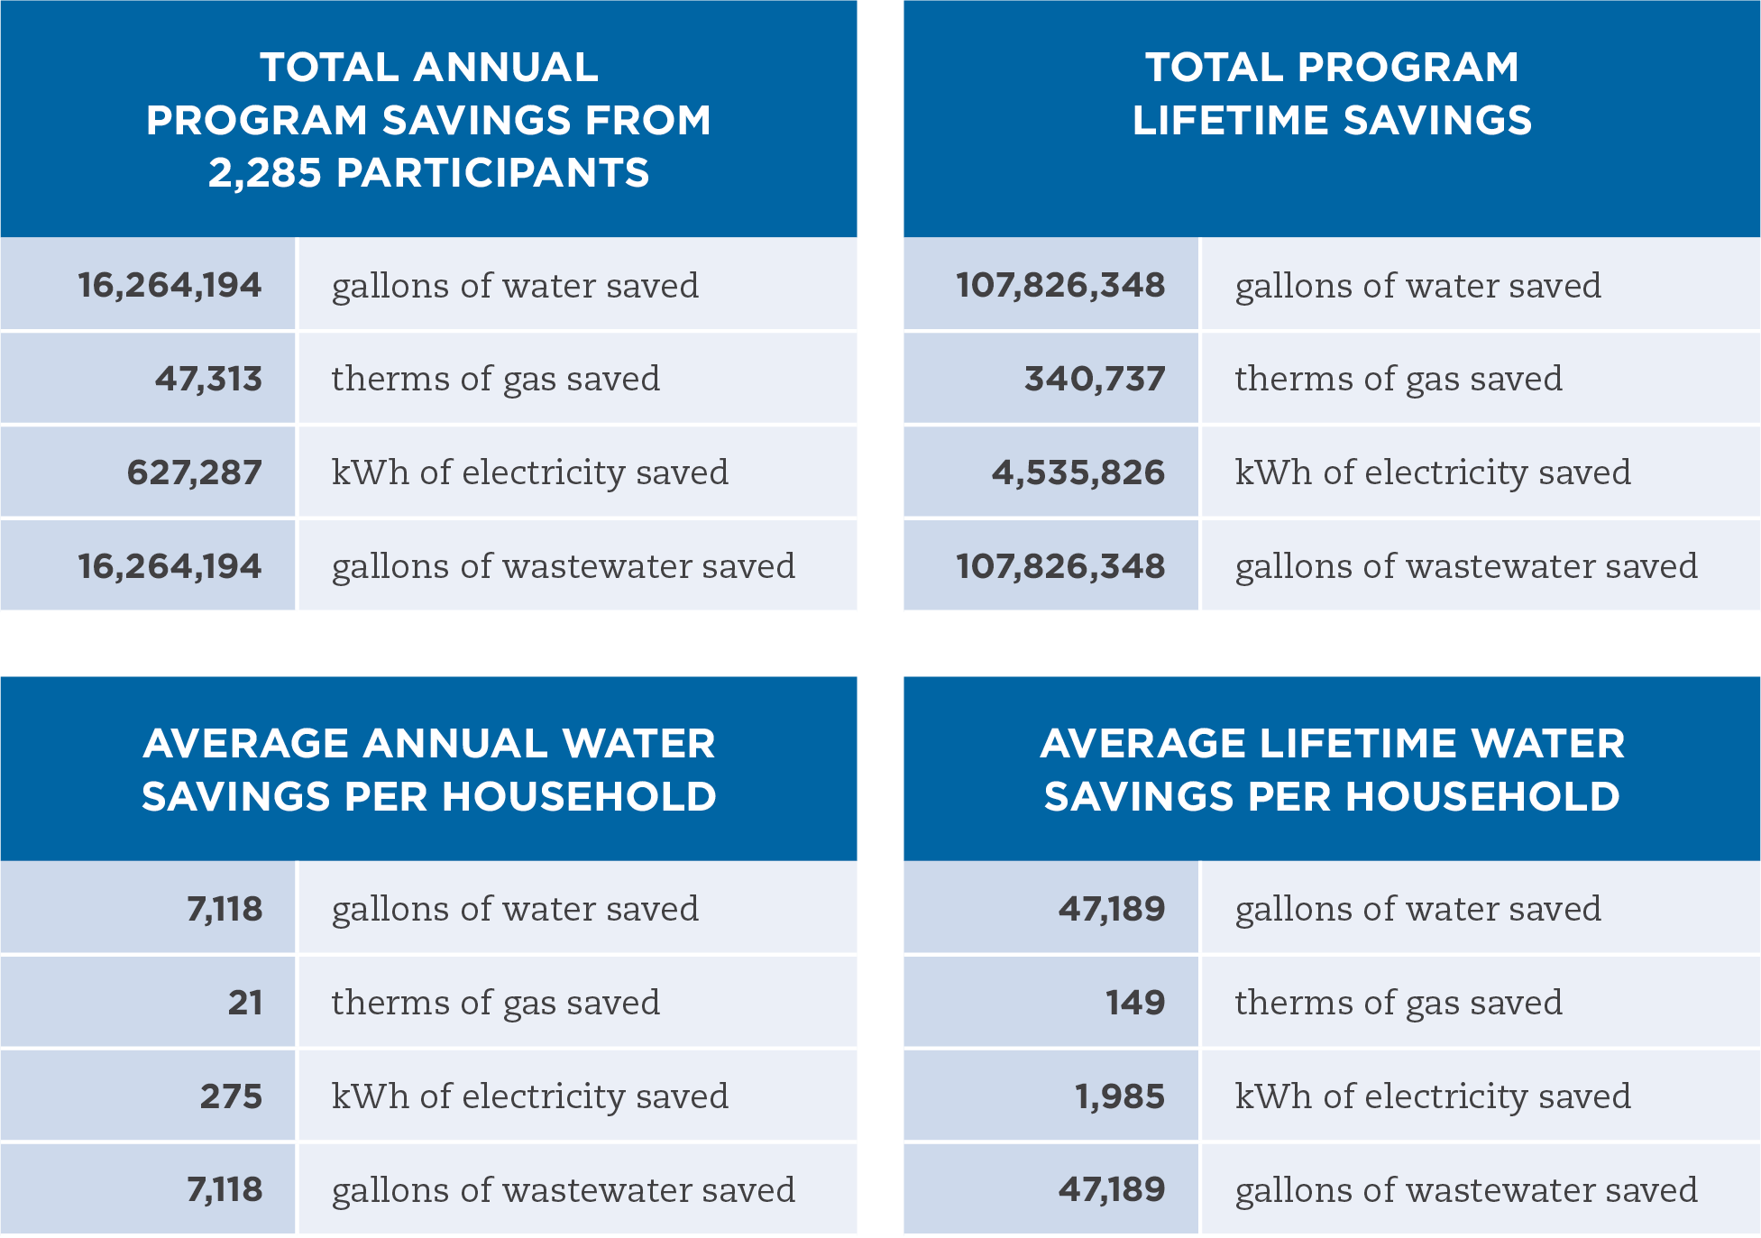
Program Savings
Texas WaterWise Program: High Plains

Slide 22
Industry Innovation &
Awards
Only CSP & 1 of 12 Honored by (AWE & ACEEE 2013)
Energy Innovator Award for LES (APPA 2014)
Corporate Excellence Award for PPL (NEUAC 2015)

Slide 23
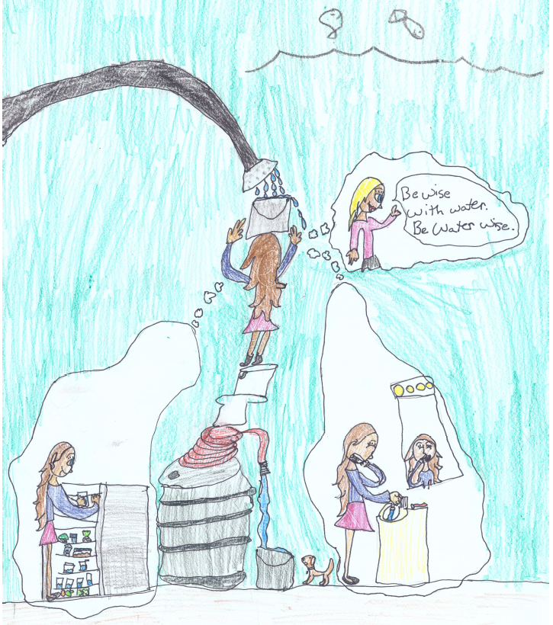

Slide 24
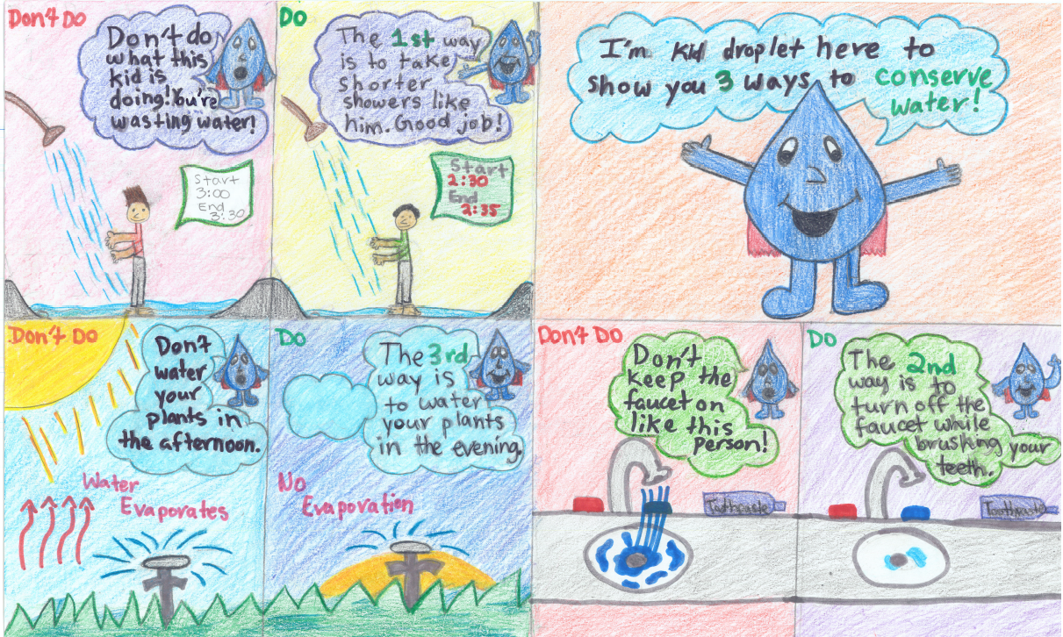

Slide 25
