Slide 1
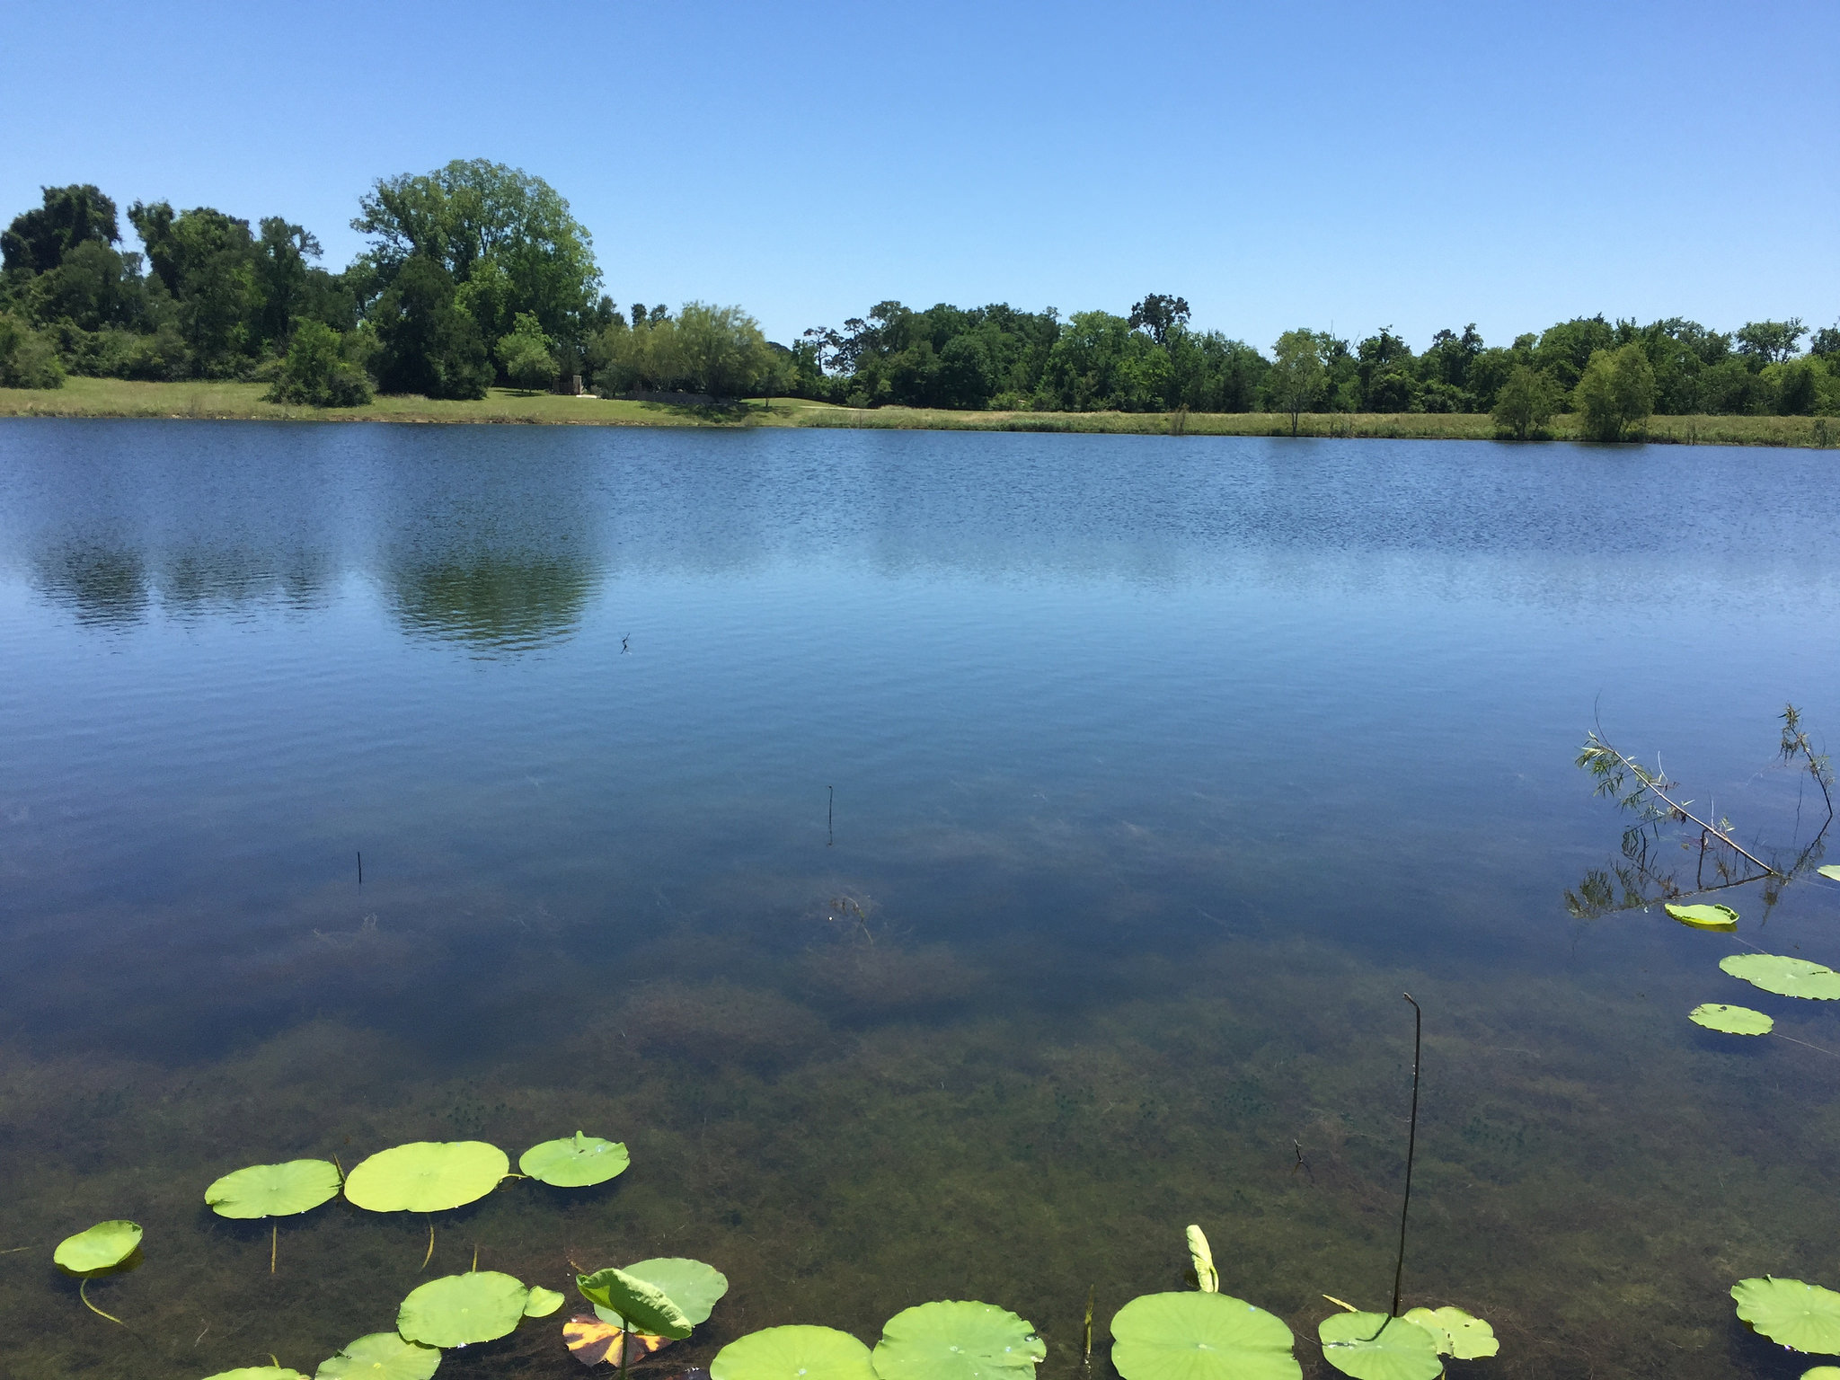
Gulf Coast Water Efficiency Network
January 24, 2019
Jill Boullion, Executive Director
Conserve Texas Land
How land conservation benefits the community

Slide 2
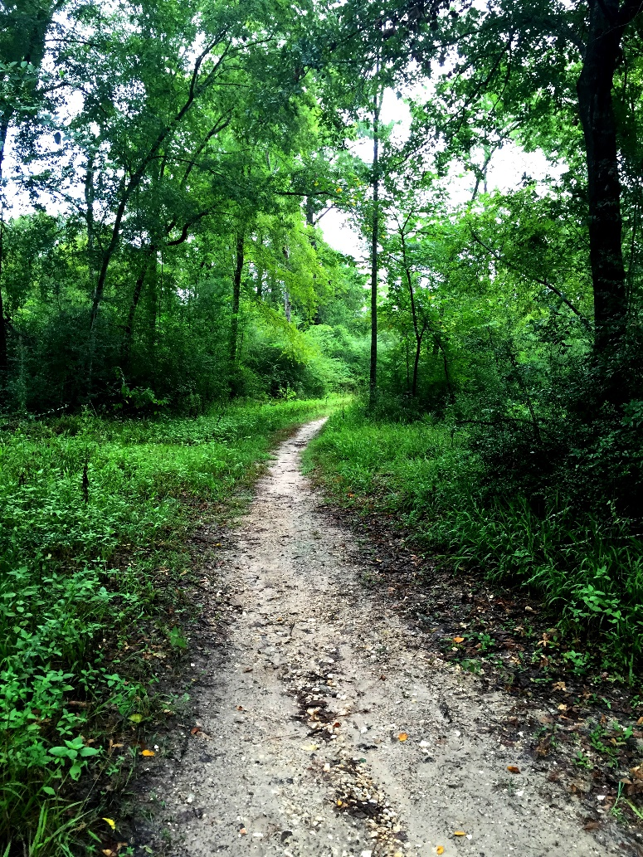
We preserve land along streams for flood control, clean water, and wildlife
MISSION

Slide 3
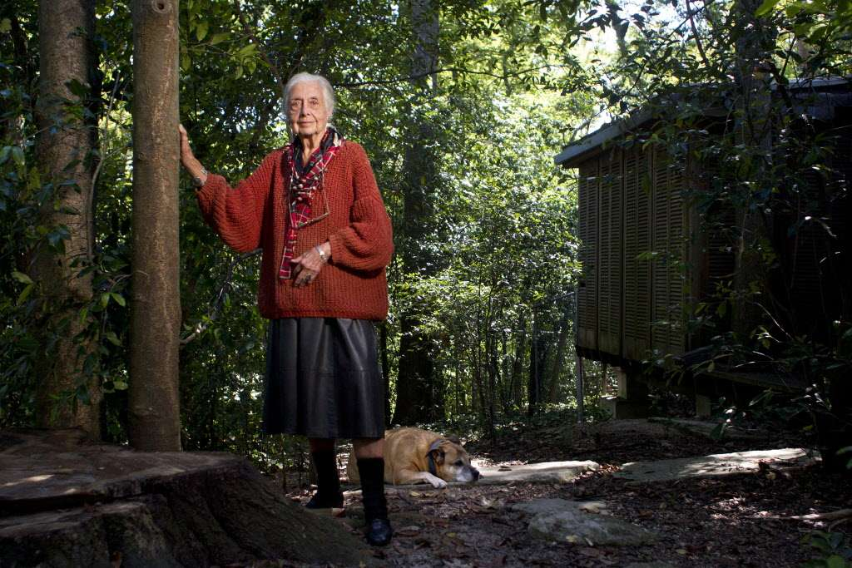
History
Formed in 1996
Land conservation committee of Bayou Preservation Assoc.
First conservation easement in 1996
Notes:
Terry Hershey organized BPA and was instrumental in our formation as well.

Slide 4
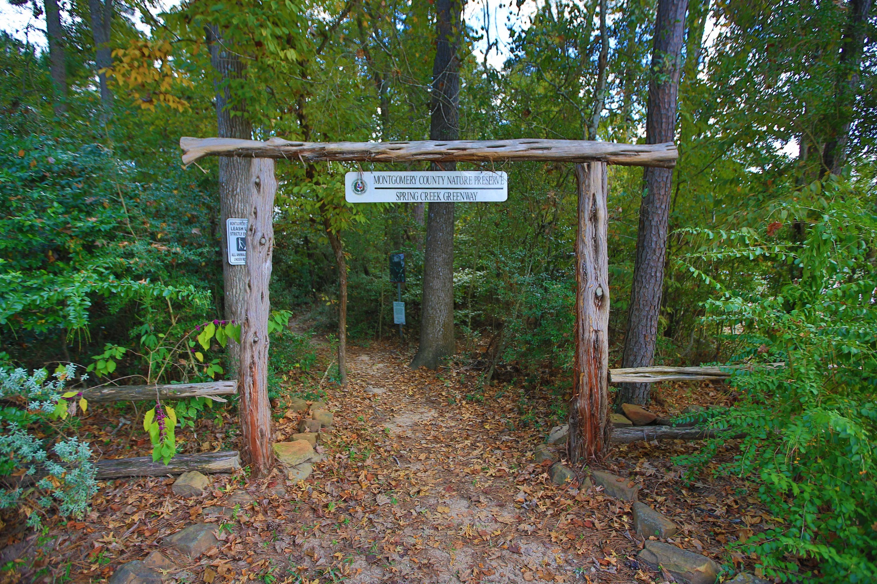
A trusted community partner

Slide 5
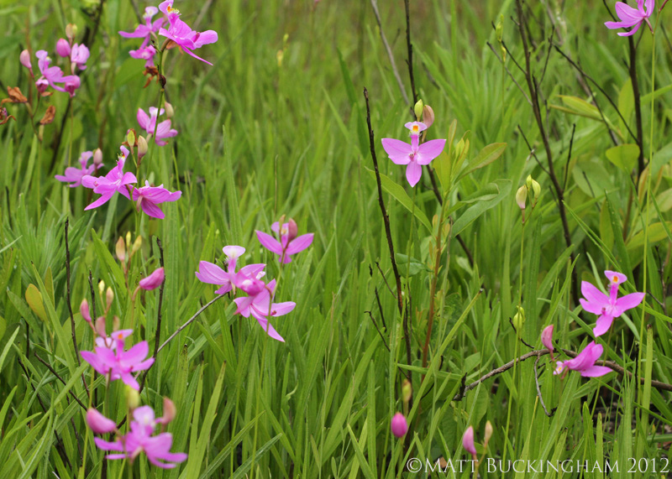
What is a Conservation Easement?
Voluntary legal agreement between a landowner and conservation organization that places restrictions on specified future uses.
Land ownership carries with it a bundle of rights—the right to occupy, lease, sell, or develop.
A landowner can give up one or more of those rights for a purpose such as conservation while retaining ownership of the remainder of the rights.
Land Trust holds the defined RIGHTS, often termed DEVELOPMENT RIGHTS

Slide 6
What is a Conservation Easement?
A conservation easement must achieve at least one of the following conservation purposes
Public recreation or education
Protects natural habitat
Scenic enjoyment
Historically important land
Must be made in perpetuity

Slide 8
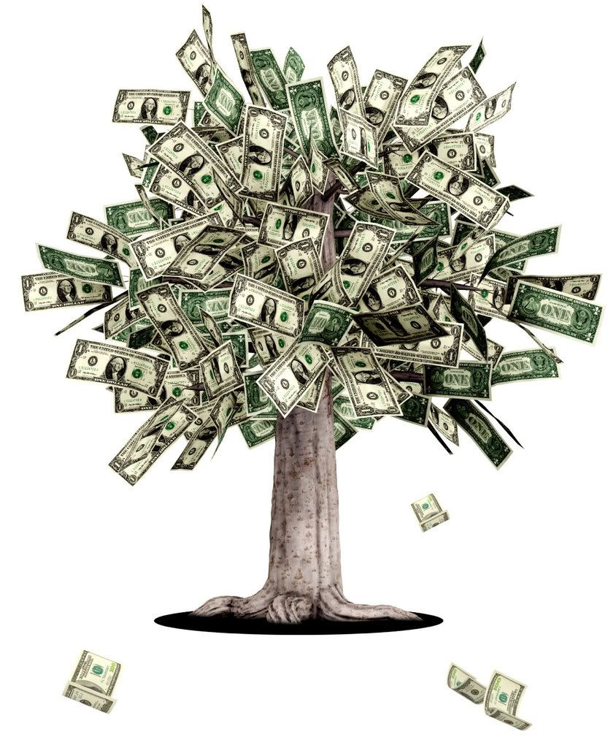
Benefits to Landowners
Reduced property taxes because of the lower value of land
A charitable donation equal to what they donated
Deducted from their taxes up to 50% of their income in the year of the gift for up to 16 years.
Farmers and Ranchers deduct up to 100% of their income

Slide 9
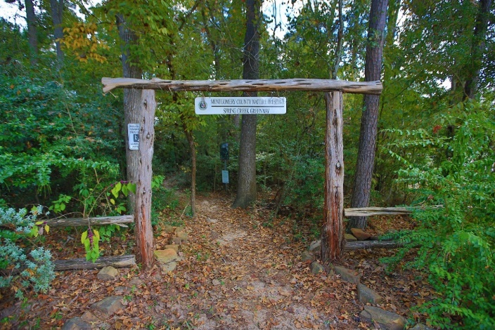
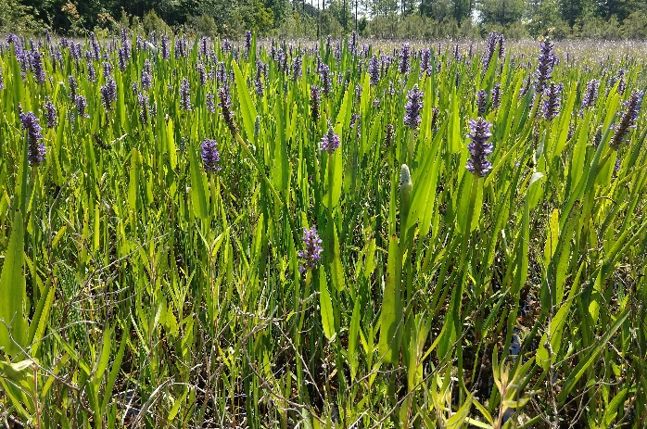
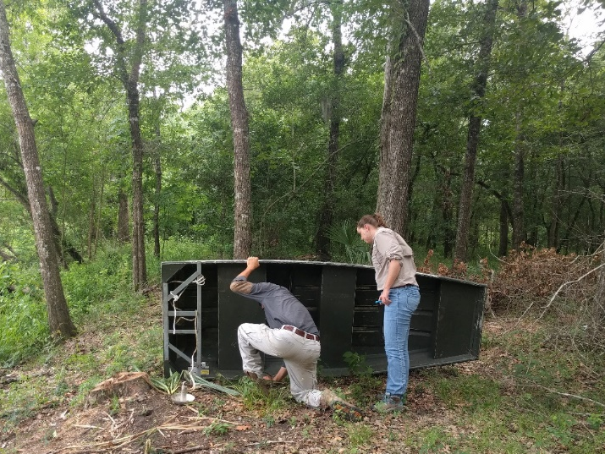
Landowner Partners
Developers and Local Governments that want to preserve their greenspaces
Wetlands preservation and restoration
Private landowners that want to preserve their legacy
Notes:
Approximately 71% of our protected lands are private (either private landowner or mitigation)

Slide 10
Land Protection Program
14,000 Acres
61 Conservation Easements
1 Owned Property
Varies from 5 to 2,000 acres
Coastal flats to wooded riparian habitat
Notes:
That’s a LOT of preserved land, especially for a local land trust. To more efficiently protect land, BLC created a focus area in 2016.

Slide 11
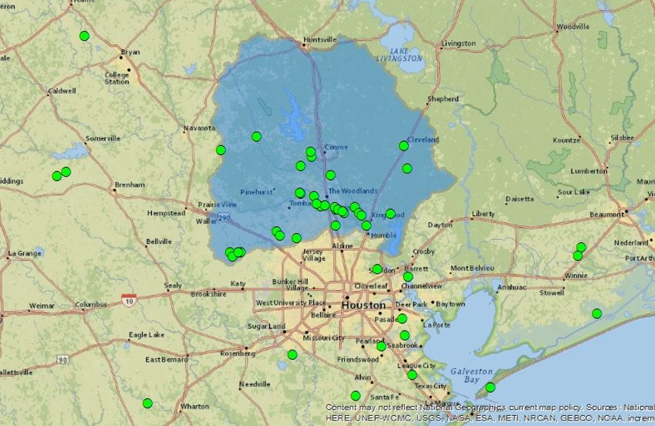
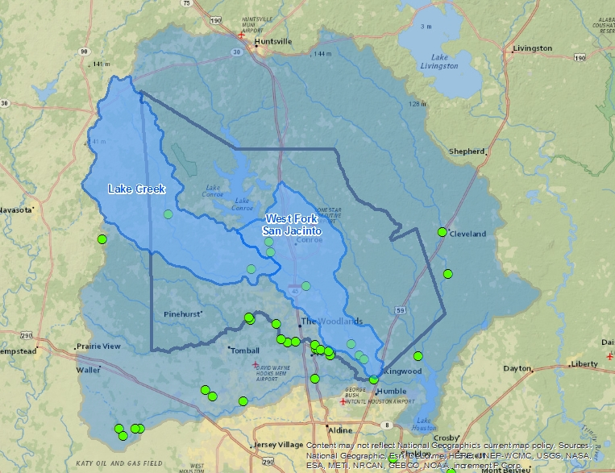
Where we work
Notes:
Now that you understand how land preservation helps communities, and can have landowner benefits – here is where we are working and focusing.

Slide 12
Strategic Conservation Plan
With BLC’s mission as a guide:
Identify important areas for BLC to protect
Create a plan toward their preservation
Community Input
Notes:
We are working to identify the types of lands that are important to our mission – and important to the community. BLC would like your input.

Slide 13
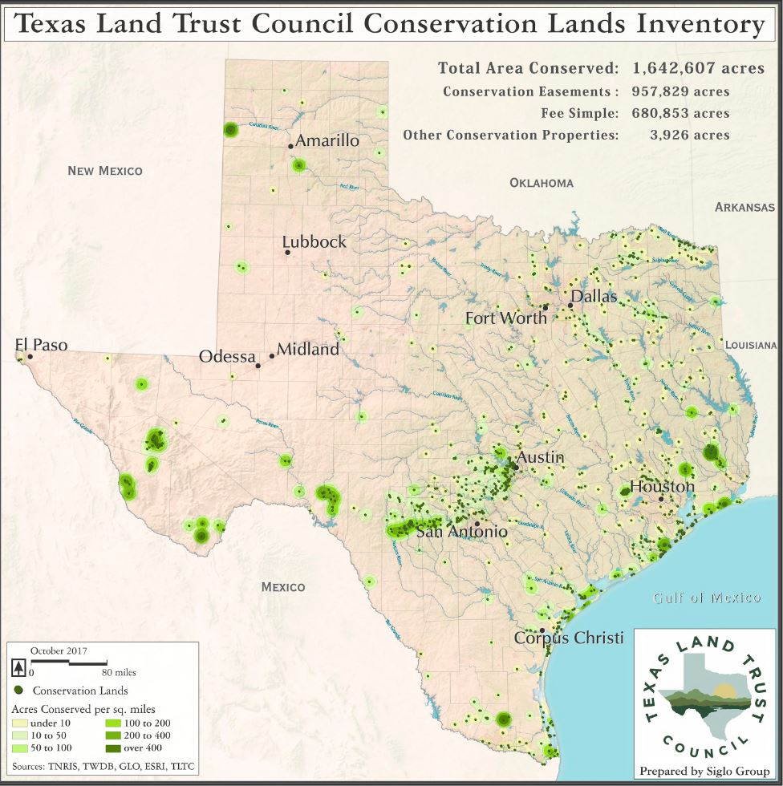

Slide 14
Statewide Flood Protection
$484m per year in construction replacement costs saved
Land conservation in floodways, floodplains and flood recharge areas has been shown to be a cost-effective solution for flood damage.
Notes:
Preserved land can make a valuable contribution to flood control. It makes room for the river.
With Harvey we saw both water inundation and sand inundation near the flooded streams.

Slide 15
Statewide Water Services
$11.5m per year in projected water filtration and cleaning costs saved
$52.6m per year in usable water provided
By conserving open lands in perpetuity, land trusts reduce costs associated with capturing, cleaning, and storing water resources.
Notes:
Cleaner surface water means lower cost of treatment and better community health
It is also important for recreation & wildlife habitat

Slide 16
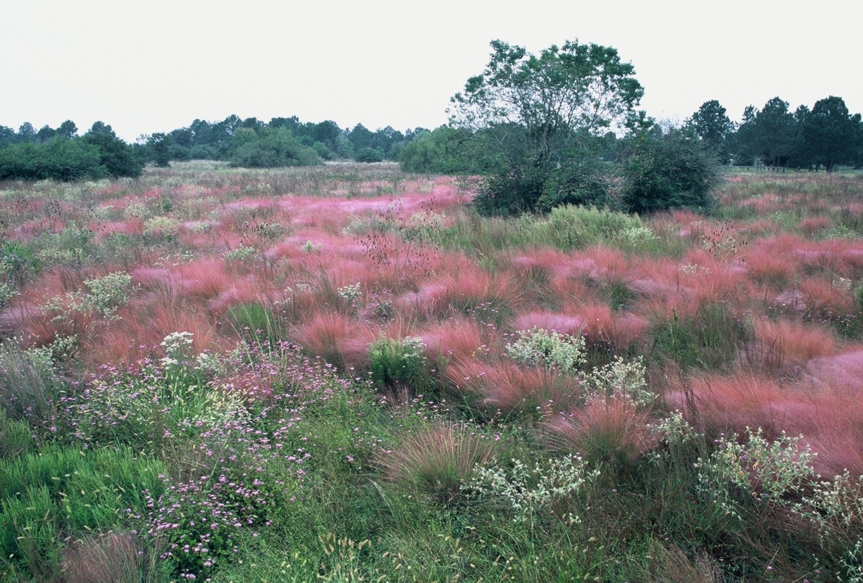
Statewide Economic Benefits
$150m per year in ag production
$11m per year in hunting and wildlife leases
Land trusts allow land owners to continue productively working the land while protecting it.
Notes:
Everyone needs a place to live.

Slide 17
Funding for Conservation
Texas Farm & Ranch Lands Conservation Program
$2m each biennium
Use to match federal Farm Bill funds
Farm Bill Agriculture Conservation Easement Program (ACEP) $450m/year. Funds wetland preservation and farmland protection.
Clean Water State Revolving Funds
Land Water Conservation Fund
Restore America’s Wildlife Act

Slide 18
More about Tfrlcp
Current funded projects protect:
8,200 acre feet of water
Water replacement Cost Value of $11.6m
Survey data shows 34% of landowners have a strong willingness to participate in state-funded land conservation programs
TFRLCP funds were leveraged 7:1
2016: 15 project applications with 7 funded
Notes:
The Texas A&M Institute of Renewable Natural Resources (IRNR) provides an evaluation report for the Texas Ag Land Trust and Texas Land Trust Council.

Slide 19
Funding for Conservation

Slide 20
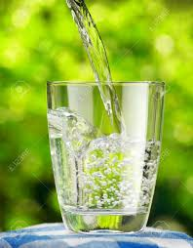
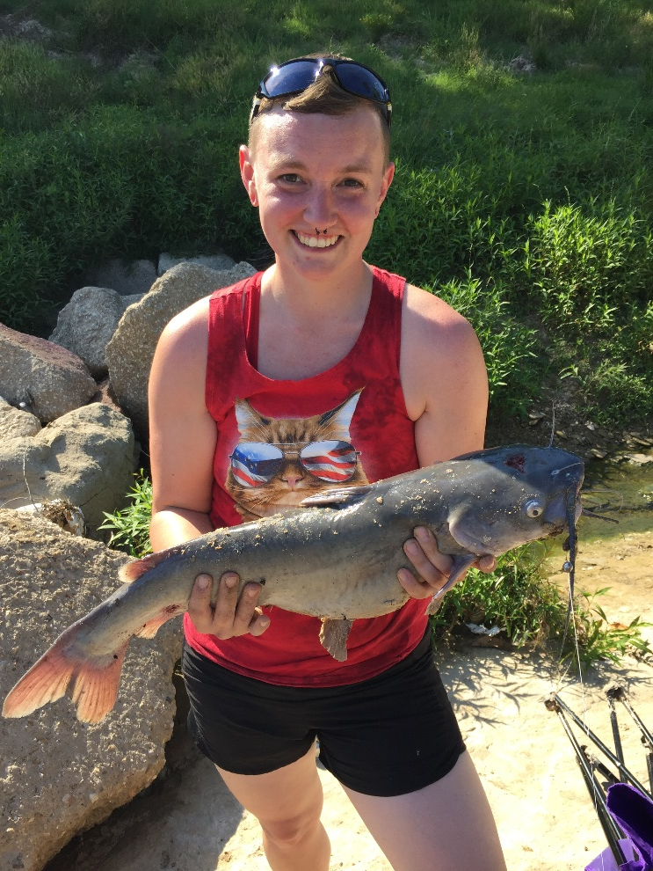
Meeting Community Challenges
The benefits of land & water
Notes:
Illustrates our mission. A bit duplicative, but may help to emotionally connect ppl to the mission.
And I specifically didn’t use a house flooded photo, b/c that’s depressing. What's not depressing is a high water mark on preserved land where no person or property was disturbed.

Slide 21
Community Connections
Spring Creek Greenway
Spring Creek Nature Trail
Spring Creek Greenway Ambassadors
No Child Left Inside
Notes:
You may know us from these programs….
These programs connect our community to preserved lands

Slide 22
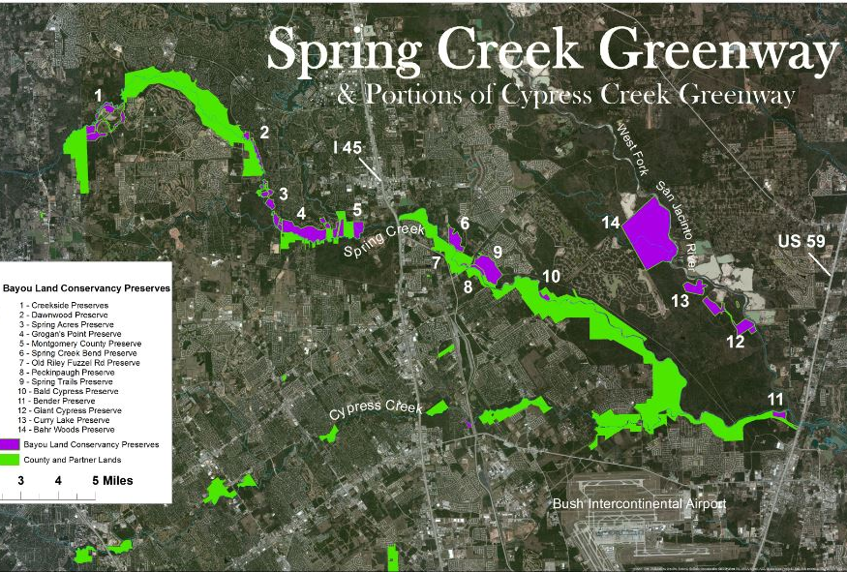
Spring Creek Greenway
Will be ~40 miles long!
Both Harris & Montgomery Counties
©Matt Buckingham 2011
Notes:
Largest Urban Forested trail in the nation, & BLC is the nonprofit partner
The purple are BLC preserves

Slide 24
Spring Creek Greenway Ambassador
Free Adult Environmental Education
Learn about our local ecosystem
Introduction to the SCGW
Opportunities to volunteer and become involved

Slide 25
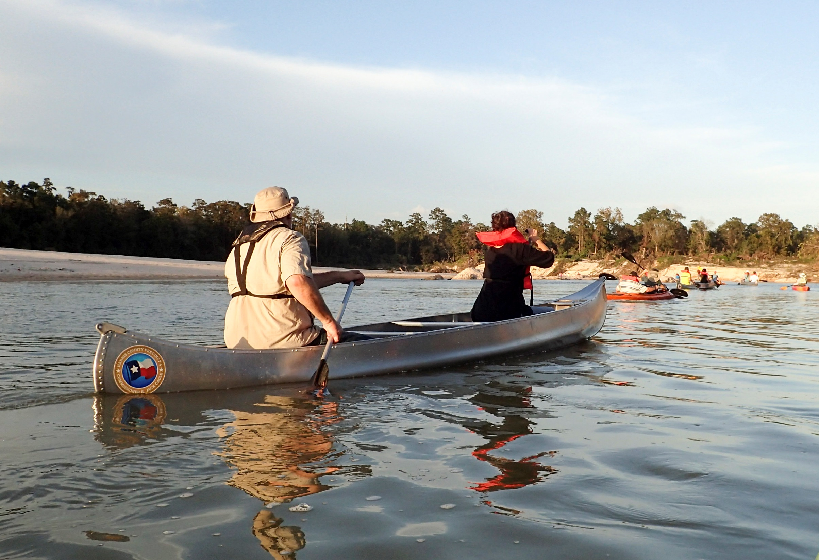
Follow us on
www.bayoulandconservancy.org
Photo by Jim Olive

